Slide 1
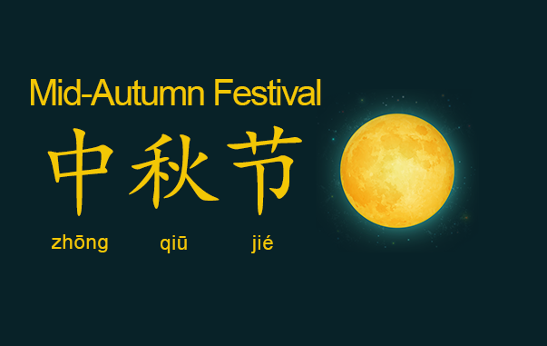

Slide 2

Facts
Name in Chinese: 中秋节 Zhōngqiūjié /jong-chiyoh-jyeah/ 'middle autumn festival'
The 2021 date: Tuesday, September 21st, with the public celebration being from September 19-21.
How it began: moon worship, over 3,000 years
Must-eat food: mooncake
Popular activities: admiring the full moon, eating mooncakes, and making colorful lanterns
Greetings: The simplest is "Happy Mid-Autumn Festival" (中秋快乐 'Mid-Autumn happy').
Notes:
Reason it is 3 days to allow people to gather and celebrate with family
Make colorful lanterns to be hung in trees or houses
Can write good wishes on them for health, harvest, mariage, etc
In some areas these are released into the sky or float on the river to symbolize a dream or wish floating away to come true
Dates are determined by festival is held on the 15th day of the 8th month of the Chinese lunisolar calendar
Ancient Chinese emperors offered sacrifices to the moon in autumn to pray for a good harvest in the coming year. Later, nobles and officials followed it, and it gradually spread to the ordinary people.

Slide 3
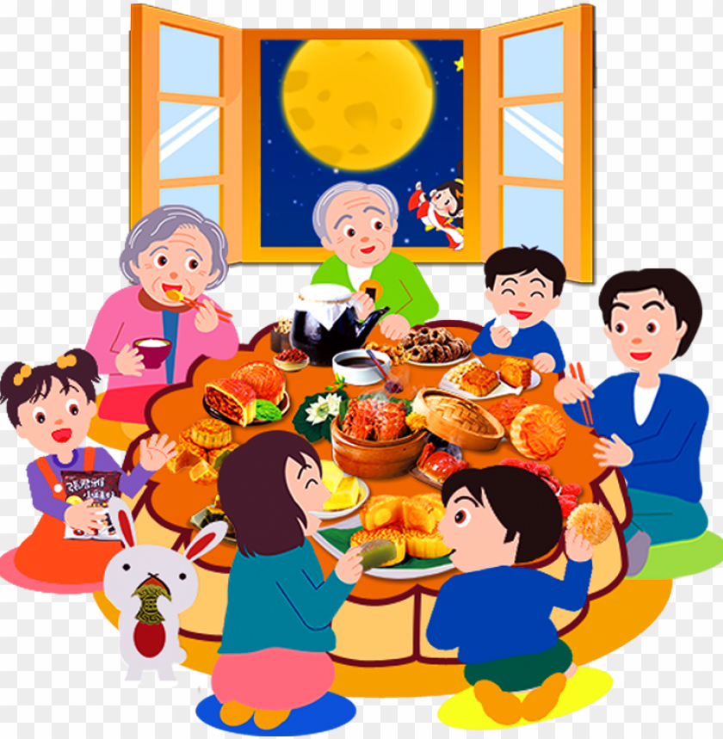
Customs
The common customs of the Mid-Autumn Festival include family members eating dinner together, just like a Thanksgiving dinner, sharing mooncakes, worshiping the moon with gifts, displaying lanterns, and regional activities.
The Mid-Autumn Festival has a history of over 3,000 years. It was derived from the custom of moon worshiping during the Zhou Dynasty (c.1045-221 BC). After that, it was first celebrated as a national festival during the Northern Song Dynasty (960–1127).
Notes:
Eat dinner together as a family bc the roundness of the moon represents the reunion of family
gifts/ offerings are made in hopes for living a long life, reunion with distant relatives and new romance
History
After the zhou dynasty it became popular in the tang dynasty with the popularity soaring among the upper class
Later in the tang dynasty the common citizens joined in on the partying and celebrating
Became a official festival in song dynasty and an official public holiday in 2008

Slide 4
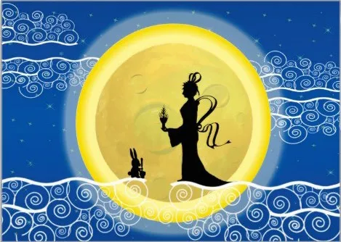
Jade Rabbit
Beggar stopped the rabbit from throwing himself to into the fire
The Jade Emperor chose the rabbit and brought him up to the moon
  The rabbit learned to create the elixirs so as a reward the Jade Emperor made his fur white
The glow made the rabbit look like a precious jade, which is how this legend got it name
Jade Emperor decided that he wanted some help for preparing an elixir of life for the immortals.
Came down to Earth disguised as as a beggar and went to search for an animal in the forest.
  3 animals came to his aid: monkey, fox and a rabbit
The 3 animals went into the forest to search for food
  monkey= returned with a lot of fruit
  fox= fish
  rabbit= couldn’t find any food
The rabbit returned later to find the man eating the food from the monkey and fish and was sad.
The rabbit realized that he could sacrifice himself so the rabbit through himself in the fire

Slide 5
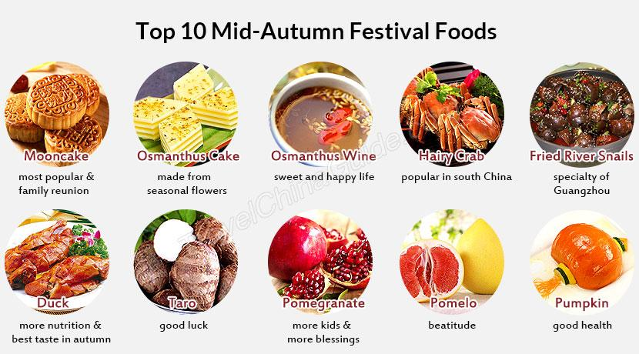
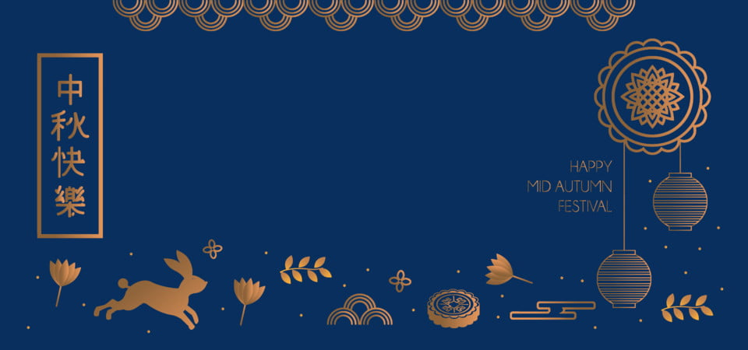
Notes:
pumpkin = good health, people in ancient times if they couldn't afford mooncakes would buy pumpkin
Fried river snails= is is believed to help brighten eyes
taro= bring good luck and wealth
Osmanthus flowers= drinking the wine is believed to signifies family reunions and a happy life
duck= more nutrition and fresh in the autumn, many different ways to cook depending on providence from
Hairy crab= seasonal delicacy that are rich in protein and amino acids
Pomegranate= more kids and more blessings
pomelo= beatitudes
Osmanthus cake= made from seasonal flavors

Slide 6
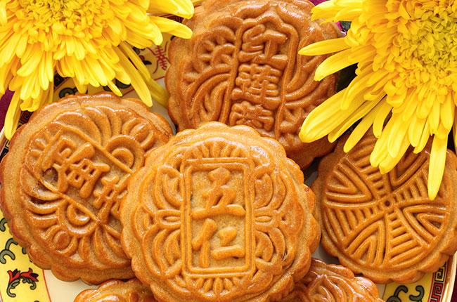
Moon Cake - yue bing
Notes:
Tradition started in the yuan dynasty
Moon cakes= represent family and harmony
Two most popular flavors are red bean and lotus seed paste
A mooncake consists of a pastry skin and some filling
First, make the pastry case with dough and syrup in equal proportions.
Then choose your favorite ingredients to make the filling.
Next, put the paste into a round mold so it starts to take shape. The mooncake can then go into the oven for baking.

Slide 7
Works Cited
https://www.chinahighlights.com/festivals/mid-autumn-festival.htm
https://www.decanter.com/wine-news/mooncakes-wine-pairing-mid-autumn-festival-377552/
https://www.chinahighlights.com/festivals/mid-autumn-festival-history-origin.htm
https://www.earthstoriez.com/china-mid-autumn-festival/
https://www.chinatravel.com/culture/mid-autumn-festival-history
https://www.pngkey.com/maxpic/u2a9o0y3e6y3q8u2/

